Slide 1
“Change-A-Heart!”
IPBYS Prison Outreach Program
FCC Butner - LSCI
Session-1
April 14, 2016
Notes:
IPBYS Prison Outreach Program
FCC Butner - LSCI

Slide 2
Who are we - the Prison Outreach?
400 Prisons
300 active inmates (of 450)
Books
Penpals
Courses
Onsite Programs
Notes:
Who are we - the Prison Outreach?
400 Prisons
300 active inmates (of 450)
Books
Penpals
Courses
Onsite Programs

Slide 3
About Course: “Change a Heart”
Understanding ourselves
Hope for Change of Life
Learn Right Philosophy
Positive Mindset
Focused Meditation
Chanting & Kirtans
Divine & Meaningful Living
Notes:
About Course: “Change a Heart”
Understanding ourselves
Hope for Change of Life
Learn Right Philosophy
Positive Mindset
Focused Meditation
Chanting & Kirtans
Divine & Meaningful Living

Slide 4
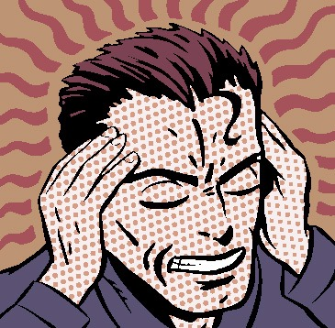
Understanding Ourselves
Are we the body?
Are we the mind?
Are we by color and race?
Are we by our birth
Who are we? None of above
Notes:
Understanding Ourselves
Are we the body?
Are we the mind?
Are we by color and race?
Are we by our birth
Who are we? None of above

Slide 5
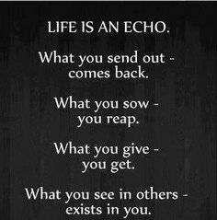
Life is an ‘ECHO’
Notes:
Life is an ECHO
What you send out - comes back
What you sow - you reap
What you give - you get
What you see in others - They exists in you!

Slide 6
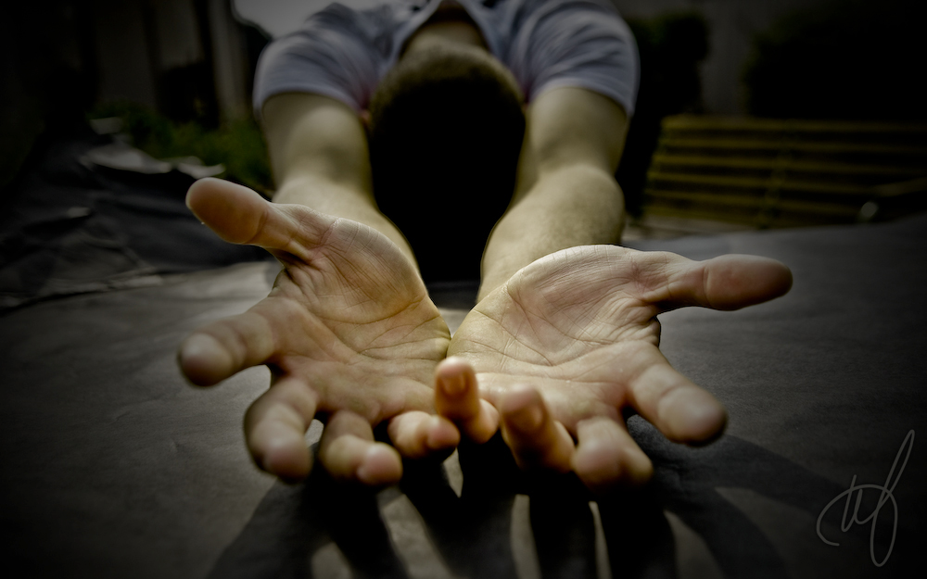
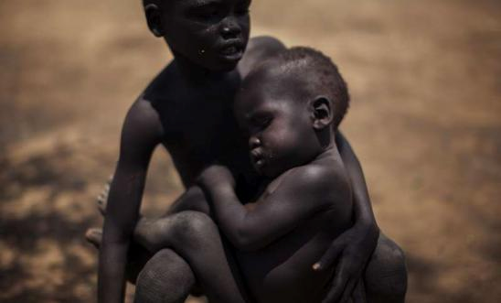
Law of Karma across lives
We reap what we planted
Notes:
Law of Karma across lives
Why suffering
We reap what we planted

Slide 7
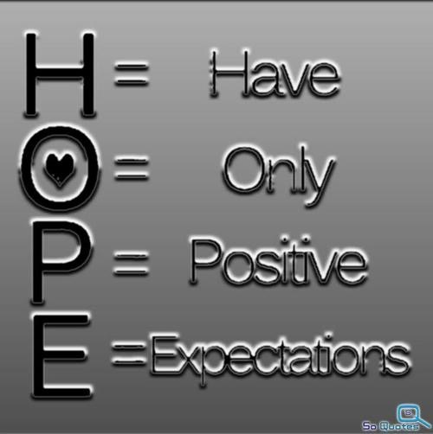
Let us “Hope” to change our life
Notes:
Let us “Hope” to change our life
H - Have
O - Only
P - Positive
E - Expectations
Meaning: Have positive attitude in life

Slide 8
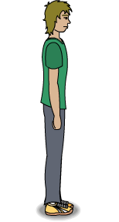
Mindfulness
Take pauses
Study how your mind goes
View as a second person
Detach yourselves
Notes:
Mindfulness
Take pauses
Study how your mind goes
View as a second person
Detach yourselves

Slide 9
Believe that we ‘will’ change!
Correct our attitude and thinking…
Compassion
Respect others
Love & Care
Serve others
Notes:
Believe that you ‘will’ change!
Correct our attitude and thinking…
Compassion
Love & Care
Serve others

Slide 10
We need ‘right’ knowledge
Those that answer the best
Those that guide you best
Those that give you hope
Those that came thru saints
Notes:
Seek ‘right’ knowledge
Those that answer the best
Those that guide you best
Those that give you hope
Those that came thru saints

Slide 11
God is Love Personified
Most compassionate
Most loving
Most caring
Most forgiving
Most intimate
Notes:
God is Love Personified
Most compassionate
Most loving
Most caring
Most forgiving
Most intimate

Slide 12
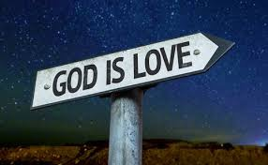
Live differently & happily!
Use Freewill right
Seek “right” knowledge
Have positive thoughts
Live simple
Live peaceful
Love God whatever way
Love attracts even God
Notes:
Live differently & happily!
Do not look back
Seek “right” knowledge
Have positive thoughts
Live simple
Live peaceful
Love God whatever way
Love attracts even God

Slide 13
Chant & Meditate
Brain with right knowledge
Mind <—> Brain
Positive thinking in mind
Interest in devotion
Chant God’s names
God’s names are very powerful
Notes:
Chant & Meditate
Mind <—> Brain
Positive thinking
Chant God’s names
(God’s names are very powerful)

Slide 14
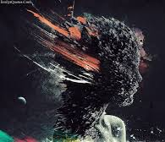
We should Control our mind
If you don’t control your mind,
surely
some one else,
or something else will.
Notes:
We should Control our mind
If you don’t control your mind,
surely
some one else will.

Slide 15
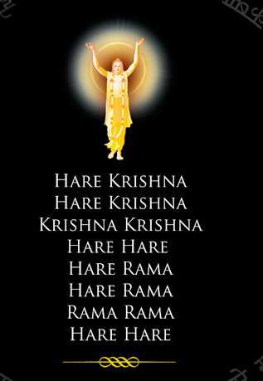
Mantra - A Way to control Mind
Mann (mind) + Tra (control)
Matra-Yoga
King of all mantras
Hare - O, Merciful God
Krishna - O, Beautiful God
Rama - O, Blissful God
In this age of quarrel,
Chant any of God’s name…
Notes:
Mantra - A Way to control Mind
Mann (mind) + Tra (control)
King of all mantras
Hare - O, Merciful God
Krishna - O, Beautiful God
Rama - O, Blissful God

Slide 16
Bhagavad Gita Can Guide
Eternal Knowledge
From Lord Krishna
Re-narrated 5,000 years ago
At War: Our life
Philosophy and about us
Karma, Knowledge, Devotion
Notes:
Bhagavad Gita Can Guide
Knowledge from Lord Krishna
Re-narrated 5000 years ago
At War: Our life
Philosophy and about us
Karma, Knowledge, Devotion

Slide 17
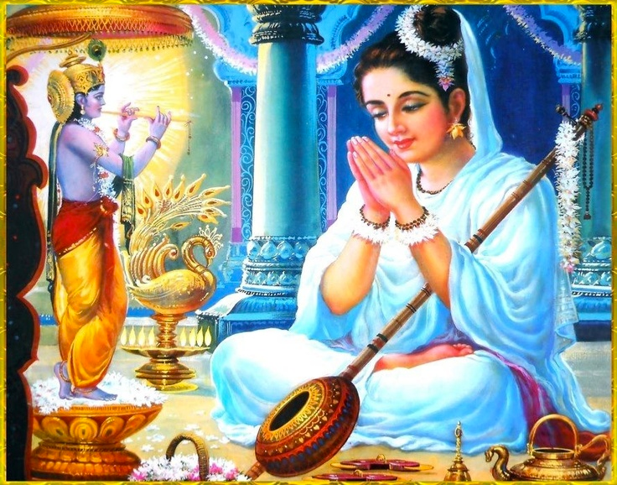
Devotion is the Best of all
Based on Love
Comes from the heart
Love is the most powerful
Devotional life purifies
Devotion is full happiness
Devotion erases all sins
Notes:
Devotion is the Best of all
Based on Love
Comes from the heart
Love is the most powerful
Devotional life purifies
Devotion gives real happiness
Devotion erases all sins

Slide 18
Devotional life erases all sins
Durena avaram karma
Buddhi yogaad dhananjaya
Buddhau saranam anviccha
Krpanaah phala hetavah .. B.G 2.49
By living devotionally, one easily gets rid of all the sinful reactions….
(No more miseries - only happy always in my spiritual kingdom - 2.50 to 2.52)
Notes:
What is the Proof? BG: 2.49.. and plenty!
Durena avaram karma
Buddhi yogaad dhananjaya
Buddhau saranam anviccha
Krpanaah phala hetavah
By living devotionally, one easily gets rid of all the sinful reactions….
(No more miseries - only happy always in my spiritual kingdom - 2.50 to 2.52)

Slide 19
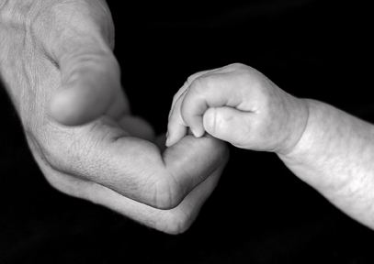
One God different names
Only one religion
May be different names
Only one God
In different names
Only one dharma
That is love of God
It is THE Jaiva Dharma
Notes:
We all part of God - Beautiful & Blissful
We are part & parcel of God
Different by Power - Like Fire vs spark
Happy & Blissful
It is our birth right to be happy!

Slide 20
We all part of God - Beautiful & Blissful
We are part & parcel of God
Different by Power - Like Fire vs spark
Happy & Blissful
It is our birth right to be happy!
Notes:
We all part of God - Beautiful & Blissful
We are part & parcel of God
Different by Power - Like Fire vs spark
Happy & Blissful
It is our birth right to be happy!

Slide 21
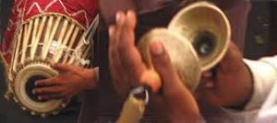
Hare Krishna Hare Krishna
Krishna Krishna Hare Hare
Hare Rama Hare Rama
Rama Rama Hare Hare
Notes:
Let us Chant & Sing Maha Mantra!

Slide 22
Any Questions?

Slide 23
Resources for you
Many Books donated to the Library
Personal Books - Bhagavad Gita
Other materials to all during course
Notes:
THANK YOU!
Followup…
Next Class - Thursday, 21, 2016?
30 mins Learning & 30 mins Kirtans
Resources
Books donated to the Library
Personal Books - Bhagavad Gita
Other special materials

Slide 24
THANK YOU!
Follow up Schedule
Thu,Apr-21- 12:30 pm - Understanding ourselves and the world
Thu,Apr-28-12:30 pm - Mindfulness, Good thoughts and actions
Thu,May-05-12:30 pm - Living in Harmony in this world
Thu,May-12-12:30 pm - This Life and & Spiritual destinations
Thu,May-19-12:30 pm - Happy forever with a “Changed Heart”
Notes:
THANK YOU!
Followup…
Next Class - Thursday, 21, 2016?
30 mins Learning & 30 mins Kirtans
Resources
Books donated to the Library
Personal Books - Bhagavad Gita
Other special materials

